Slide 1
French at WEPA

Slide 2
Language Learning in the National Curriculum
Foreign language teaching at KS2 may be of any modern or ancient foreign language and should focus on enabling pupils to make substantial progress in one language.
There are no prescribed topics, but focus should be on ‘familiar and routine matters’.
Teaching should
provide a balance of spoken and written language
enable pupils to understand and communicate ideas, facts and feelings in speech and writing with increasing confidence, fluency and spontaneity
lay the foundations for further foreign language teaching at KS3
Notes:
equip children with skills and strategies that will help with language learning at KS3, even if learning other languages

Slide 3
The Main Benefits of Language Learning
Language learning
opens up avenues of communication
promotes and instils a broader cultural understanding
raises awareness of children’s own language and makes comparisons with the foreign language, thereby enriching understanding of both
develops general memory and language learning skills/ strategies and the ability to recognise rules and patterns in a new language which leads to increasing independence
supports oracy and literacy and stimulates creativity and confidence. Children link the spelling, sound and meaning of words. They ask and answer questions, listen to, read and understand stories, songs, poems and write. Lessons involve animations, games, singing, mimes, role play, conversations…

Slide 4
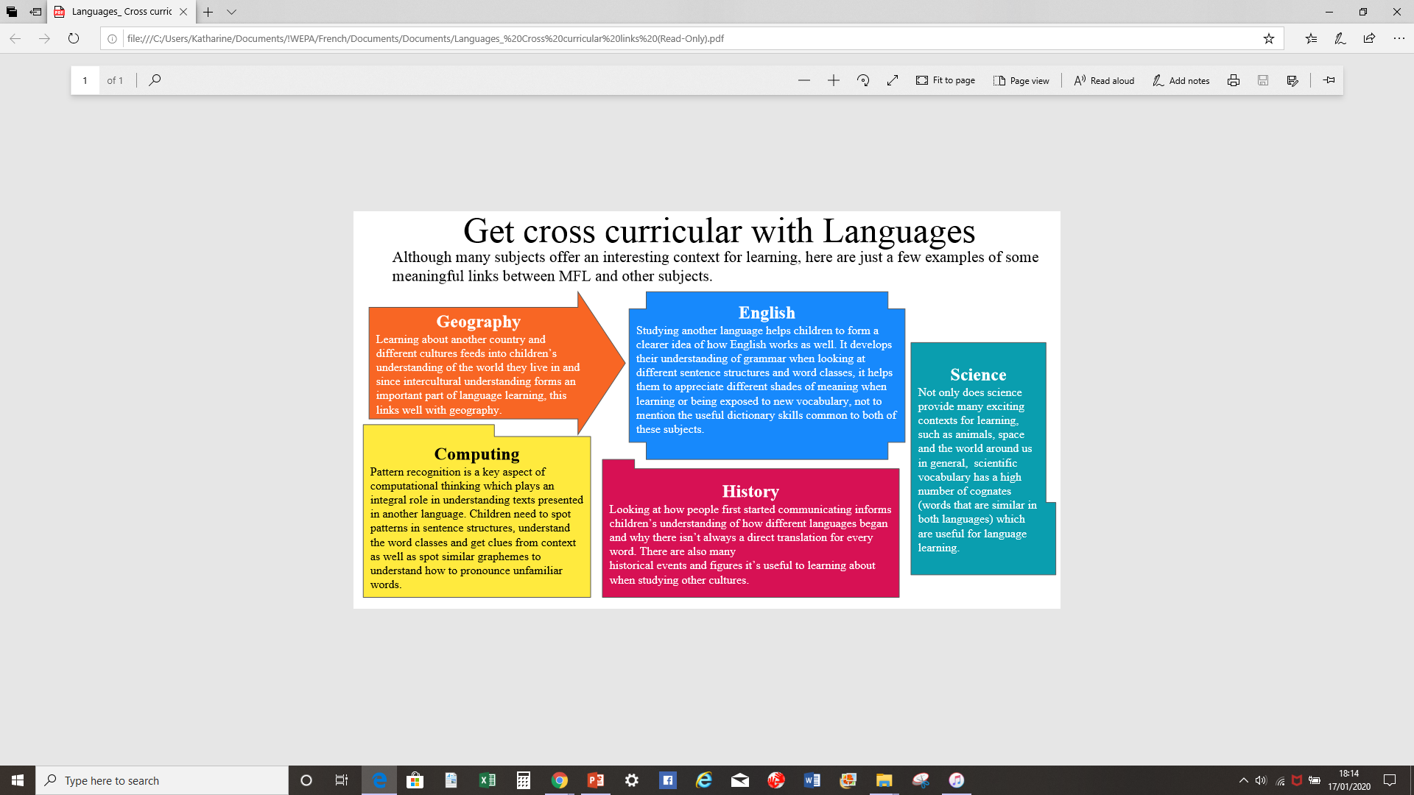
Notes:
Geography: y3 where French is spoken History: Bastille Day, origins of fairy tales, Degas/Picasso English: sentence structures, word classes, gender, dictionary skills Computing: pattern recognition Science: cognates, engineering Eiffel towers in Yr1

Slide 5



Slide 6
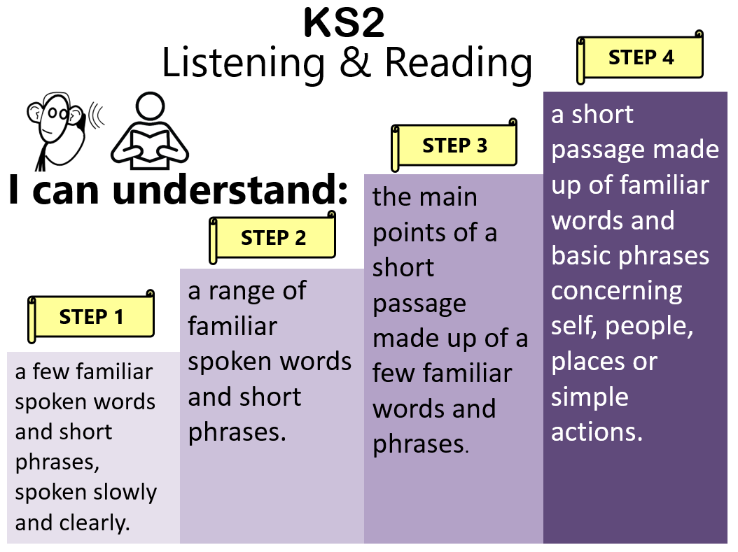
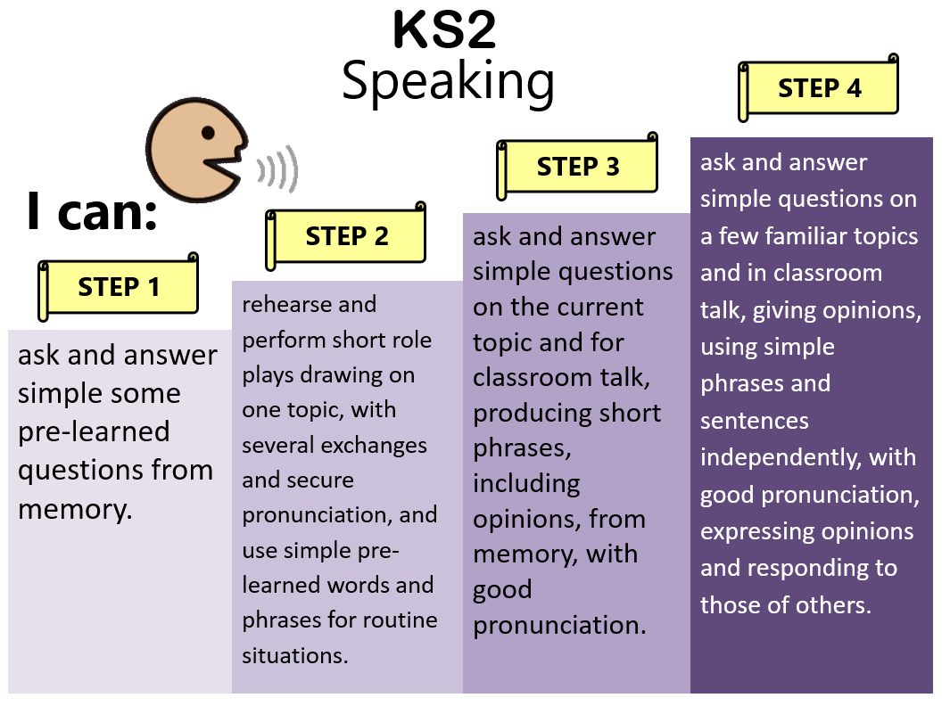
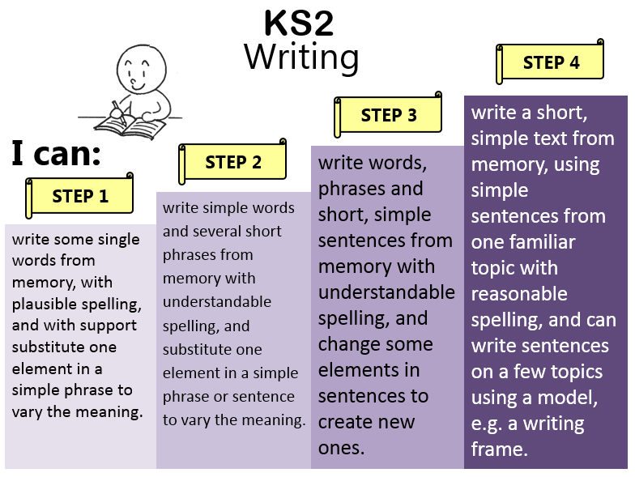
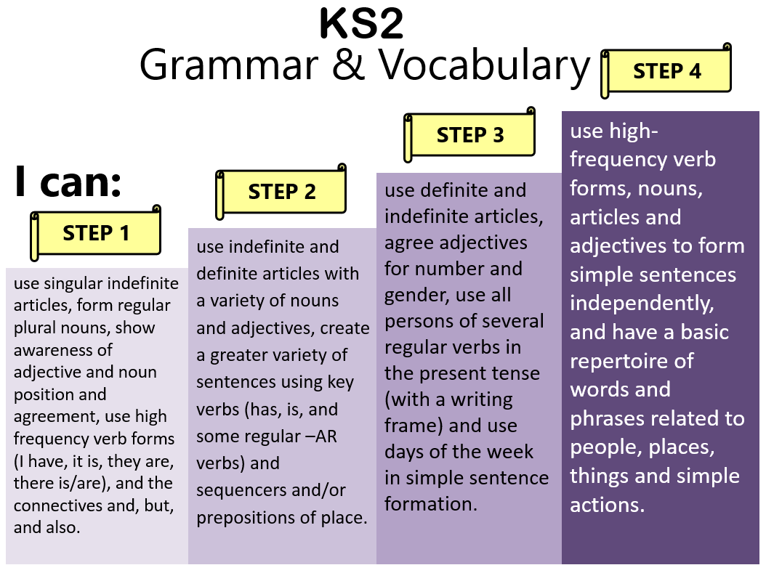
Progression
Notes:
Word level to sentence level across a few to several topics, answering questions to asking and answering, expressing opinions, writing from memory, using models and then writing with decreasing support

Slide 7
Progression (examples)
Giving personal details: answering with one word → asking and answering in full sentences
Likes and dislikes: revisiting with each new vocab group. Year 3: basic opinions of playground games, Year 5/6: wider range of opinions (music, films) + justifications
Adjectival agreements: Year 3: monster description (colours), Year 5: beach/ planets description (position, size, temperature, colour), Year 6 physical description of teachers (range of adjectives)
Verbs: Year 3: basic verbs (to have, to be, to play), Year 4: to do/make, to go, verbs + prepositions, Year 5: wider range of verbs in context of beach activities, Year 6: more verbs in context of school life and verb groups/ looking for patterns in verb endings eg –er verbs, introduction to conditional (je voudrais)
Notes:
Build on previous activities and ensure progression

Slide 8
A high-quality experience
Government wants 90% of pupils to sit a language GCSE by 2025
WEPA uses the Rising Stars ‘Euro Stars’ scheme, which is designed for specialists and non-specialists. Six units per year.
Animations (CD Rom), flashcards, activity sheets, native French speaker audio support, pronunciation guides and planning includes links for extra support
Notes:
Secondary schools are aware that language is statutory at primary level so expect chn to have some skills, even if just grammar. White Paper research into primary languages/ new ofsted inspection framework
There is more planning than you can get through in 30 mins but it’s meant to be flexible/ pick and choose/ good ideas not to be missed

Slide 9
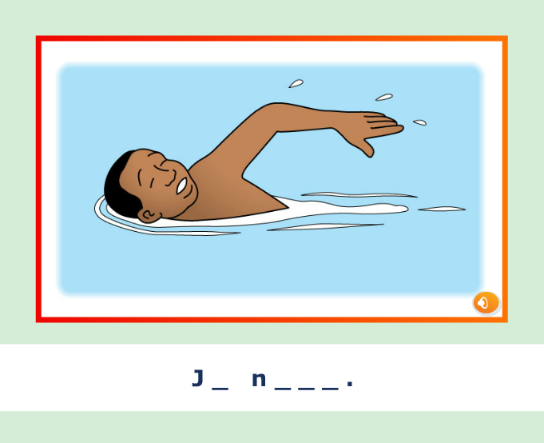
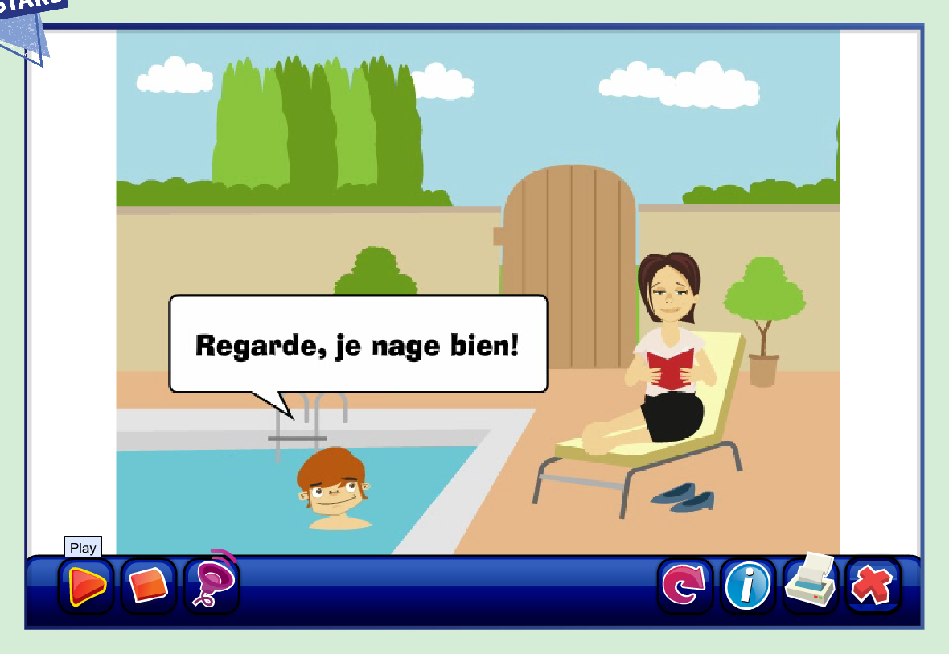
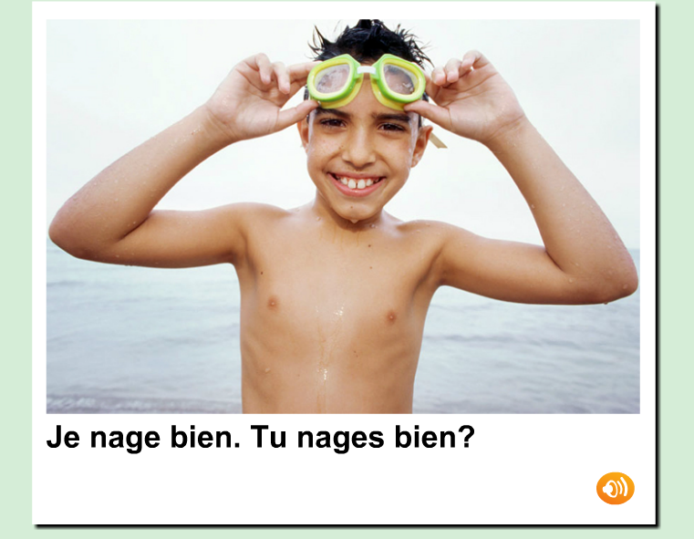
Euro Stars scheme

Slide 10
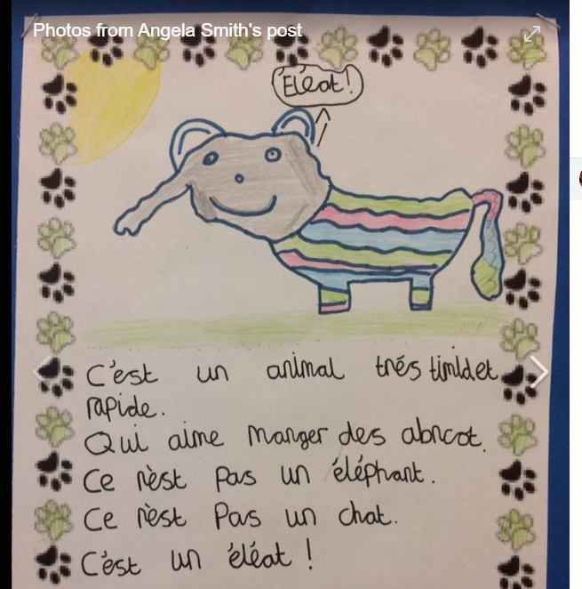
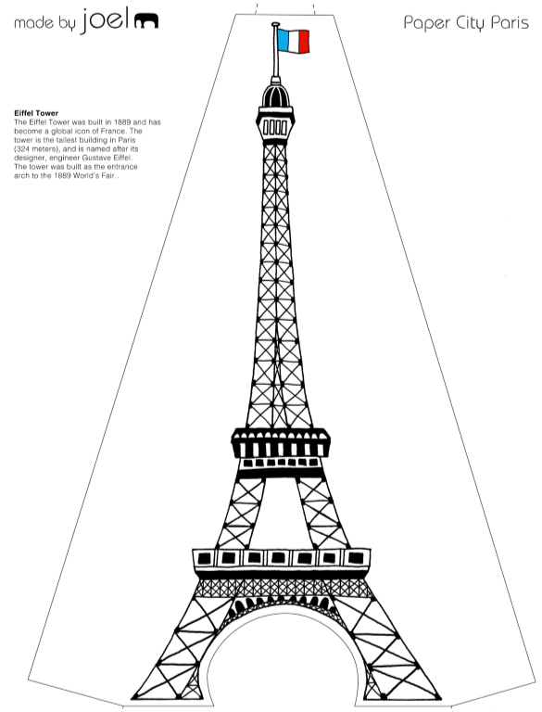
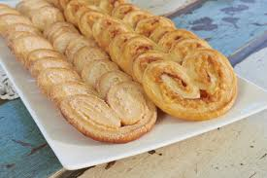
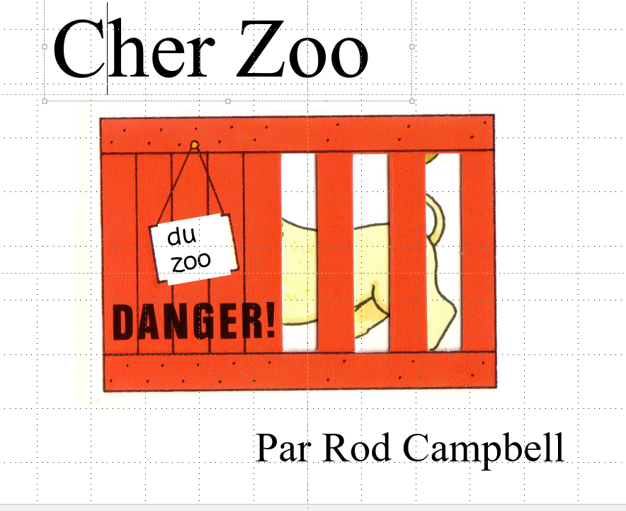
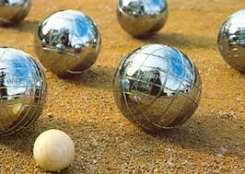
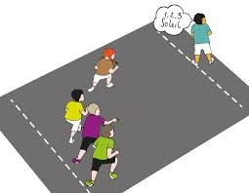

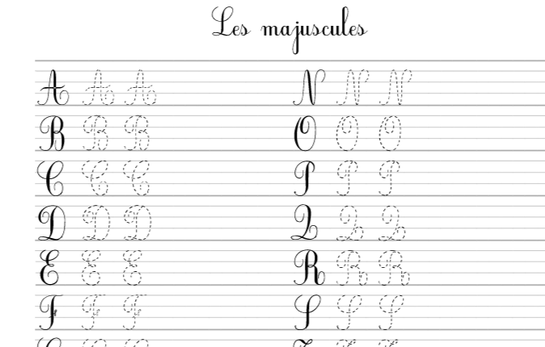

Initiatives
Bastille Day celebrations
Greater Depth challenge cards
French club

Slide 11
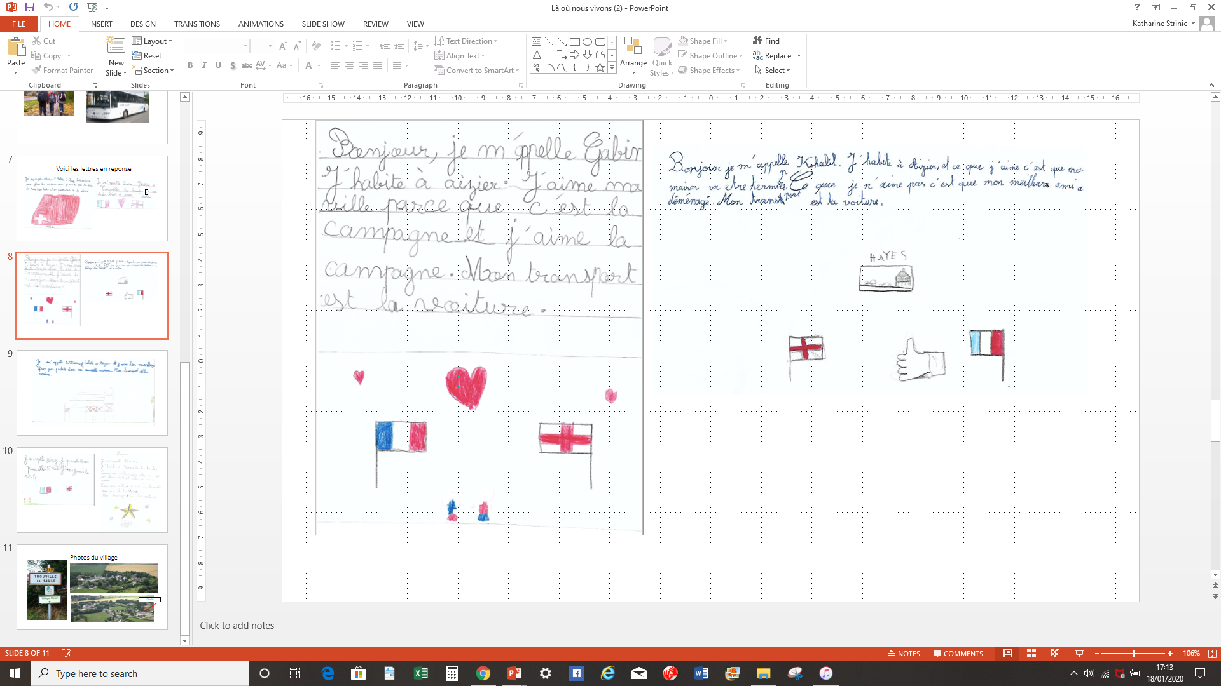
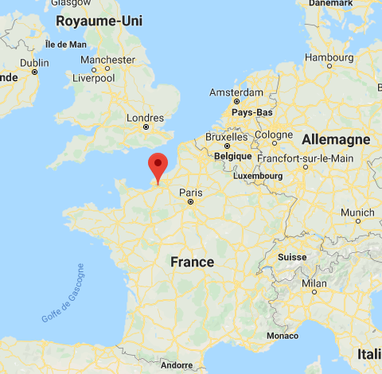
Twin school – Trouville-la-Haule, Normandy
Notes:
Resources?

Slide 12
Little but often…
Easy ways to consolidate language…
Write the date in French on the board every day
Write the order of the day ‘e.g. L’ordre du jour’ up in French
Take the register in French (it’s an excellent recapping tool e.g. pupils must give a number / colour etc.)
Pupils use some common classroom questions
Each morning, ask ‘What is the weather like?’
If pupils are packing up they can count to up to 20 / 30 …in French together. Teacher can do countdowns too.
Greetings – ‘Bonjour – Ça va?’ Use the target language to greet pupils in the morning. This helps pupils to incorporate the TL as a natural and spontaneous part of the day.

Slide 13

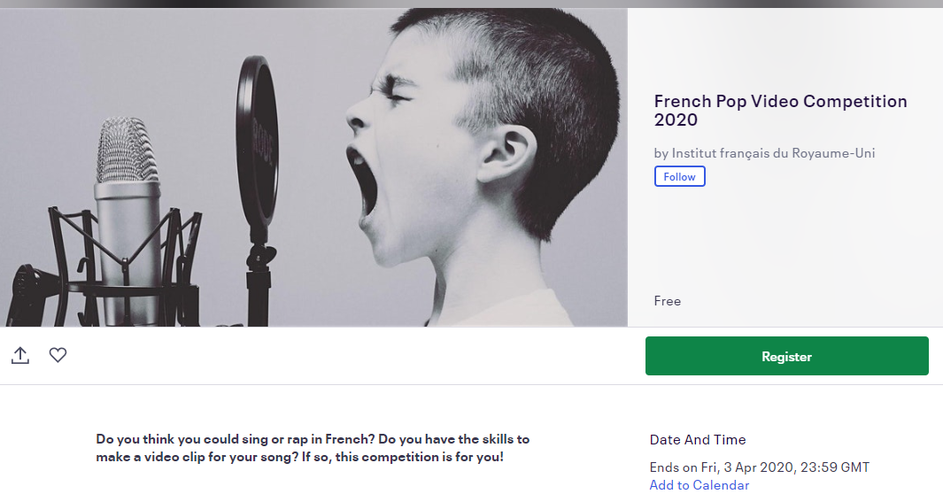
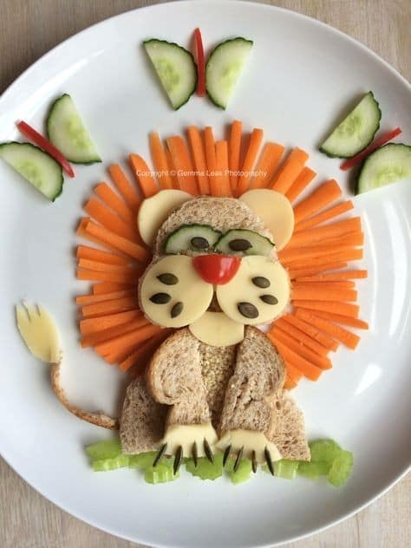
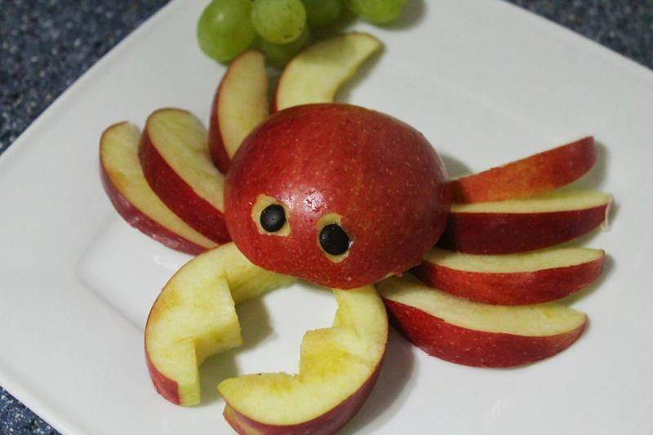
Other ideas
Language ambassadors
French breakfast/ café
British Council International School Award

