Slide 2
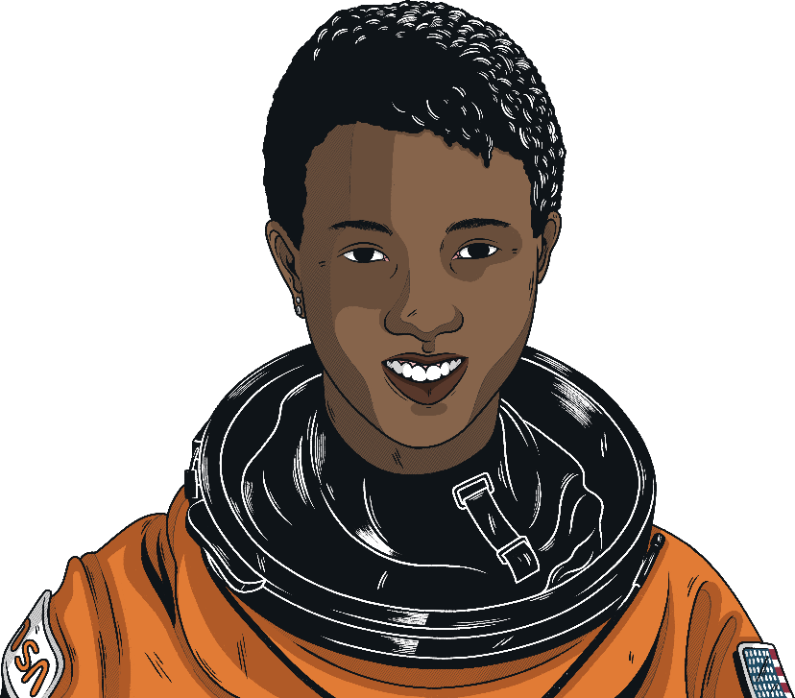

Who is Mae Jemison?
Never limit yourself because of others' limited imagination; never limit others because of your own limited imagination.
Dr Mae Jemison (1956 – present day)
Mae Jemison is a doctor, teacher, inventor and former astronaut.
She lives and works in the United States of America.
Her achievements demonstrate the importance of working hard, having self-belief and setting yourself ambitious goals.
For Mae Jemison, the sky is certainly not the limit!

Slide 3
Early Life
Mae Carol Jemison was born on 17th October 1956 in Decatur, Alabama in the United States of America. Her mother was a teacher and her father was a carpenter and roofer. She was the youngest of three children.
Education was important to her family and, when she was three years old, they moved to the city of Chicago to take advantage of the better schools found there.
At school, Mae Jemison was hard-working and high-achieving. She loved all areas of science and, even at the age of 5, knew that she wanted to be a scientist.
Her uncle was influential in her early life, introducing her to science at every opportunity. She developed a lifelong interest in astronomy.

Slide 4

Education and Early Career
In high school, Mae Jemison became interested in biochemical engineering and at the age of 16, she enrolled at Stanford University to study this subject.
In 1977, she was awarded degrees in chemical engineering and African-American studies.
Think:
Why do you think Mae Jemison chose to become a doctor rather than a dancer?
During her time at university, Jemison devoted time to theatre and dance. Her real passion for dance meant that she would eventually have to choose between being a doctor or a professional dancer.
Having chosen to be a doctor, Mae Jemison went on to attend Cornell University where she gained a doctorate in medicine.
She began work as a general practitioner in a medical centre.
Her real interest lay in international medicine and she worked for two years as a medical officer for the Peace Corps in Liberia and Sierra Leone.
Amongst her other academic achievements, Jemison is also fluent in Russian, Japanese and Swahili.

Slide 5
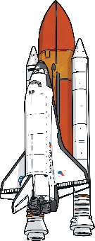
The Race to Space
As a child, Jemison loved reading about space and watching TV shows. One of her favourite shows was Star Trek and Jemison credits the character Lieutenant Uhura with being an early role model. Jemison felt as though she too could be a woman in space.
Later in life, she jumped at the chance to play a role in one of the episodes of Star Trek: The Next Generation.
Think:
What do you think Mae Jemison would have done if she had not been selected as one of the 15 candidates for the astronaut training programme?
Mae Jemison decided to follow her dream of travelling to space.
She applied to be admitted into NASA’s astronaut training programme and in 1987, she became one of only 15 people chosen from more than 2,000 applicants. She was the first Black woman to be admitted.
In September 1992, she also became the first Black woman to go into space, aboard the Endeavour space shuttle.
Mae Jemison spent 8 days in space, alongside 6 other astronauts. She was a mission specialist, carrying out experiments on weightlessness and motion sickness.
An interesting fact about Mae Jemison is that she is scared of heights. She never let this fear hold her back though, saying: “It’s a weakness only if it keeps you from doing stuff.”

Slide 6

Retirement?
In March 1993, Mae Jemison retired from NASA. She certainly had no plans to put her feet up and relax. Her drive and determination soon had her looking for new goals.
The thing that I have done throughout my life is to do the best job that I can and to be me.
Today, she runs her own research and development technology company: The Jemison Group.
Her company’s projects focus on improving healthcare and technology in the developing countries of the world.
Mae Jemison is also currently leading the 100 Year Starship Project to ensure that human space travel to another star will happen within 100 years.
Her incredible achievements have led her to have the honour of being inducted into the National Women’s Hall of Fame and the International Space Hall of Fame.

